Slide 1

Alphastar
A StarCraft 2 AI by Google’s Deepmind

Slide 2

What is StarCraft 2 - Intro

Slide 3
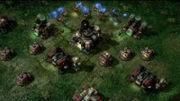
What is StarCraft 2 – Gameplay

Slide 4
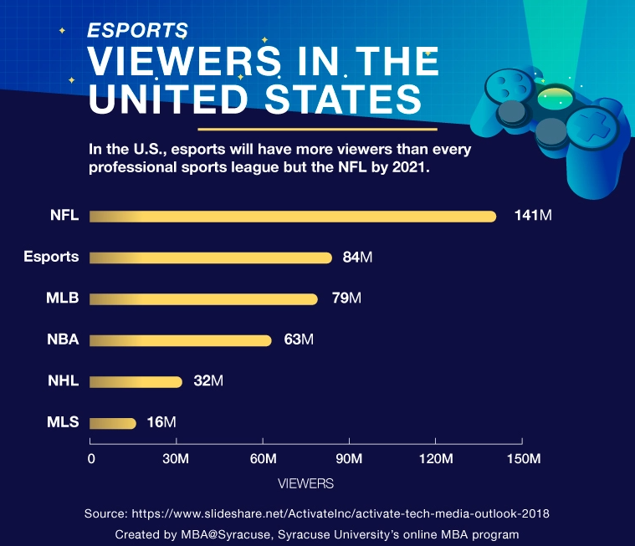
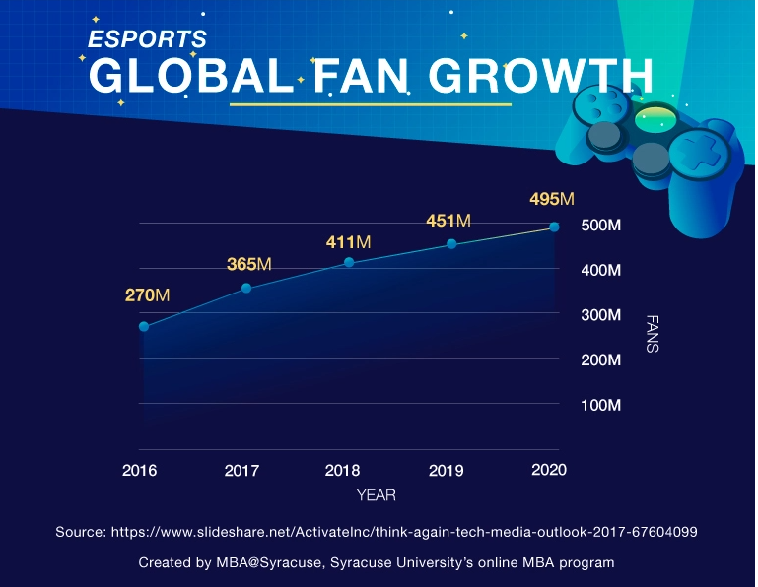
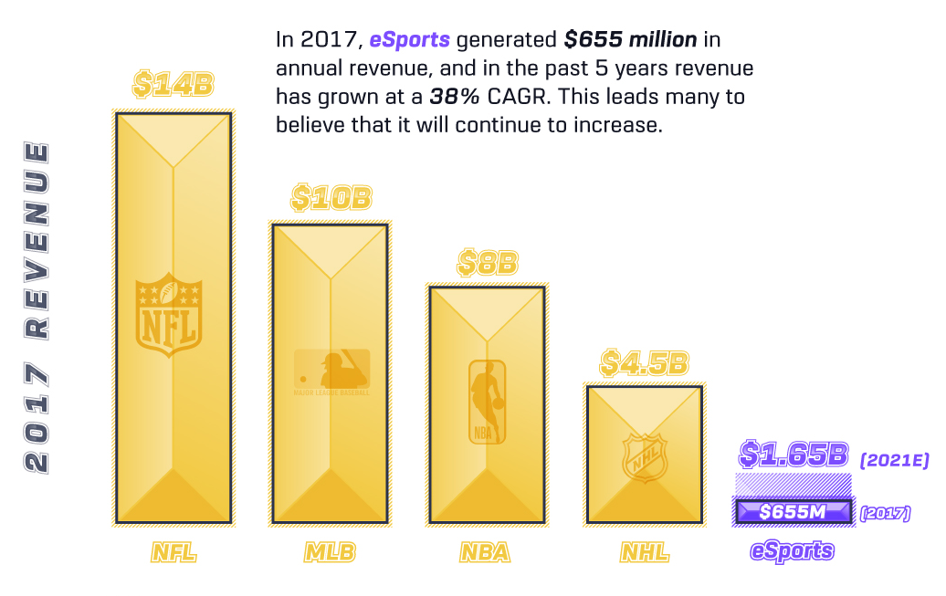
eSports is a Thing

Slide 5
Why StarCraft II?
The need to balance short and long-term goals and adapt to unexpected situations, poses a huge challenge for systems that have often tended to be brittle and inflexible.
Game theory: Like rock-paper-scissors, there is no single best strategy. An AI training process needs to continually explore and expand the frontiers of strategic knowledge.
Imperfect information: Unlike games like chess or Go where players see everything, crucial information is hidden from a StarCraft player and must be actively discovered by “scouting”.
Long term planning: Like many real-world problems cause-and-effect is not instantaneous. Games can also take anywhere up to one hour to complete, meaning actions taken early in the game may not pay off for a long time.
Real time: Unlike traditional board games where players alternate turns between subsequent moves, StarCraft players must perform actions continually as the game clock progresses.
Large action space: Hundreds of different units and buildings must be controlled at once, in real-time, resulting in a combinatorial space of possibilities. On top of this, actions are hierarchical and can be modified and augmented. Our parameterization of the game has an average of approximately 10 to the 26 legal actions at every time-step.

Slide 6
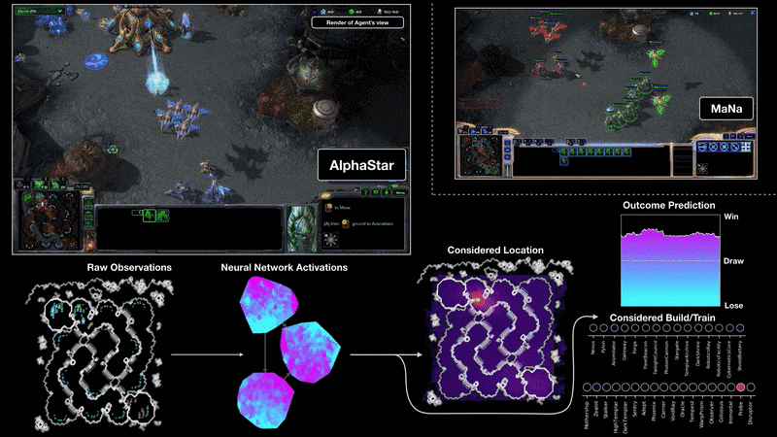

Slide 7
How is Alpha Star Trained?
AlphaStar’s behaviour is generated by a deep neural network, receiving input from the games interface and out puts a sequence of instructions or actions to take within the game.
AlphaStar also uses a novel multi-agent learning algorithm. The neural network was initially trained by supervised learning from anonymised human games
- Learning by imitation
- This initial agent could defeat the games in-built “Elite” AI in about 95% of games
Following this a multi-agent reinforcement learning process.
- Basically playing against versions of itself in an AI league

Slide 8
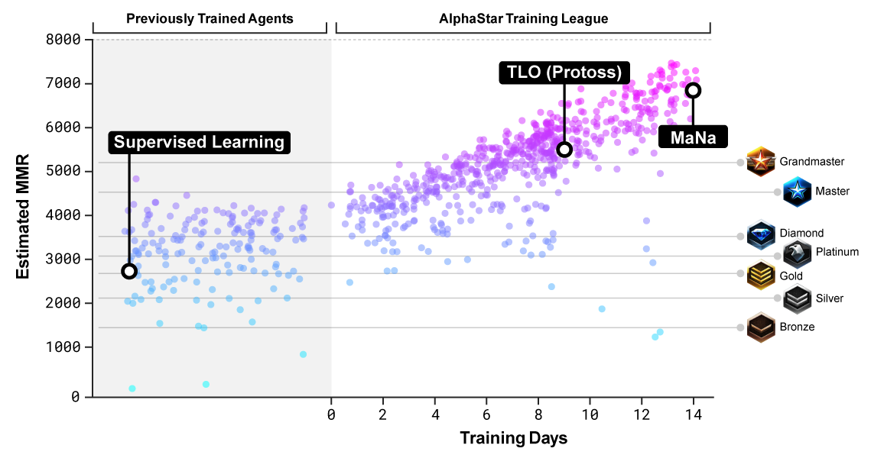

Slide 9
Early on in this league “cheesy” strategies were favoured by AlphaStar
Later these risky strategies were discarded in favour of gaining economic strength
Similar to a human player’s development
To encourage diversity in the league each agent had it’s own learning objective.
Perhaps one to beat a specific competitor and another to beat a distribution of competitors.
For training The AlphaStar league was run for 14 days on 16 TPUs (Tensorflow Processing Units).
Each agent gaining the benefit of up to 200 years of real
The final agent consists of a mixture of the most effective strategies and can run on a single desktop GPU

Slide 10
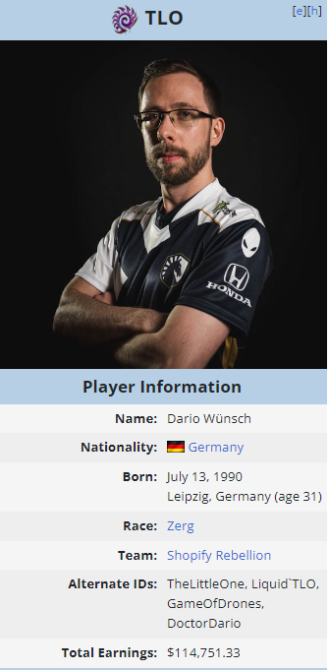
0-5

Slide 11
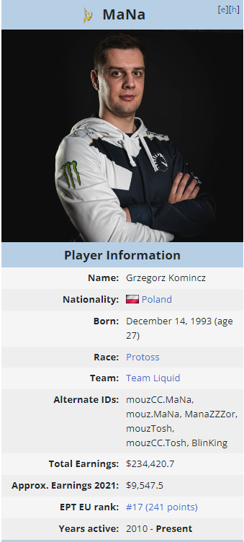
0-5

